Slide 1
Lecture 1
SetUp and Basic R

Slide 2
Directory
Your HWs and DIS will use these paths that will help automatically load datasets and save your files.
You can do it manually but it’s a little complicated. You can write your own paths which I will show you how to later but I don’t recommend.

Slide 3




,
,
……
lecture
week01
week02
,
,
……
hw
hw01
hw02
,
,
……
dis
dis01
dis02
,
,
……
Desktop
STAT240
data
only one folder here that will be given later in the semester
scripts

Slide 4
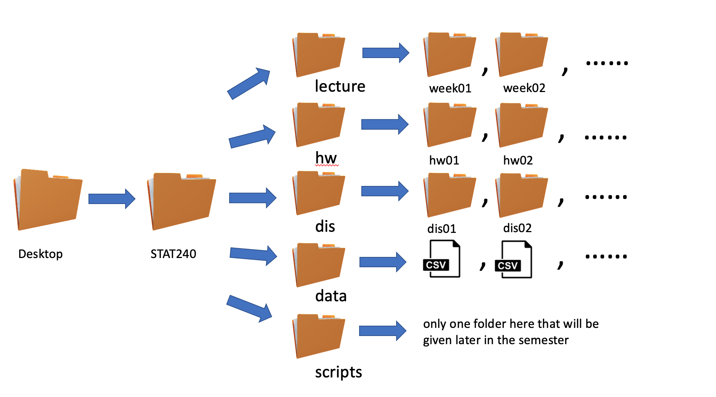
You can manually write the path to directories:
Mac Users: “~/Desktop/STAT 240/name of the folder that you want to go to/name of the next folder/name of the file”
Window Users: “C:User/Desktop/STAT 240/name of the folder that you want to go to/name of the next folder/name of the file”

Slide 5
RStudio
The panels/tabs of Rstudio
Console/Terminal/Background tab
Environment/History/Connections/Tutorials tab
Files/Plots/Packages/Help/Viewer Tab
Source tab

Slide 6
Console tab
The bottom left box/tab.
Place where all the codes are RUN and the output is printed. This is the brain of RStudio and uses the R that you installed. Without installing R, you can’t use the console.
You can use the console to write your code directly. But it doesn’t save them in a file for future use.
To save your code in a file, use the SOURCE tab.

Slide 7
Source Tab
Here you can create different R-friendly files to store your codes such as R script (.R files), R Markdown (.Rmd files) and such.
We will mostly be using the R Markdown files for this course.
You can run the codes directly from the Source into the Console, using Cmd/Option + Enter (for Mac users) or Cntrl/Shift + Enter (for Window users)
Structure of R Markdown files:
YAML: The part between the ‘---’ and contains instructions on the format of the output document
Normal Text: Here you put the textual information. For mathematical notations you can use LaTeX notations.
Code Chunk: All the code in an Rmd file goes inside a chunk. A chunk can be added using the shortcuts Ctrl+Alt+I (Windows) or Command+Option+I (Mac). To run the codes use shortcut

Slide 8
Environment Tab
The top right-hand side window contains the Environment tab. This is the tab where you can visualize the variables, functions, datasets, and other objects defined during the session.
This window also consists of the history tab which is really helpful if you run codes in the Console. You can obtain all the codes run if the workspace was saved.

Slide 9
Files/Plots/Packages/Help/Viewer Tab
This is the bottom right window in Rstudio.
The Files tab in this window shows all the files on your computer.
The Plots tab displays the plots made.
The Packages tab shows all the R packages downloaded to your computer. Packages can be downloaded using ‘install.packages(“package name”).
Packages need to be loaded for each R session. Base R package gets loaded by default every time you open RStudio, but except for that, you are required to load the packages you need using ‘library(“package name”)’.

Slide 10
Files/Plots/Packages/Help/Viewer Tab
The Help tab provides information about all functions in the R packages. You can directly search for the functions in the tab. Or put ‘?’ in front of the function name in the console.
The Viewer tab shows the html files after compiling your source files.

Slide 11

R Markdown (RMD) file
This is the format we will be saving(/using) most of our course files as.
This format helps add text and code (along with it’s output) into the same file.
Best part: The viewer doesn’t need to run your codes to view the output!! You can also choose which codes (and/or outputs) to include in the final document.
An rmd file needs to be knit (or compiled) to create the desired output document. It can be compiled by using the knit option at the top menu bar of the source.

Slide 12
Part of Rmd file
YAML: This is the part of the document that decides what the output will look like.
The YAML section is at the start of the file. It begins and ends with three dashes, --- alone on a line.
You can adjust various aspects of an rmd file through its YAML section, such as title, author, date, and the type of output (pdf/html/webpage/presentation/many more) you want the document to produce.
In this course, we will mostly use the output as html.
Useful Link: https://bookdown.org/yihui/rmarkdown/rmdformats.html

Slide 13
Body: This is where you will be putting texts, equations, and code chunks for the output file.
For text, type whatever you wish to. Anything that starts with # becomes headings. You can create sections using the #, which also creates headings. To create subsections/subheadings, use more #.
For code, chunks can be entered using the shortcut
Command+Option+I (Mac)
Ctrl+Alt+I (Windows)
Equations can be entered using LaTeX symbols or environments, such as using $$

